Slide 1






Senior Design Project:
Cognitive Assistance with LiDAR
Localization (C-ALL)
Project Release
Ahmad Shah, Neeti Mistry, Sara Gaber & Sohan Chatterjee
Notes:
TUESDAY April 8
Ahmad: 18-19, 29-31
Neeti: 1-9, 23-26, 32-35
Sara: 13-14, 20-22, 27-28, 36-38
Sohan: 10-12, 15-17

Slide 2



Introduction
Brief overview and summary of project

Slide 3

Introduction
Objective: Develop an affordable, real-time navigation system for visually impaired individuals
Utilizing LiDAR technology integrated into newer iPhone Pro 12+ models for real-time navigation
Technology Stack: LiDAR, Swift, Geographical ARKit, Bluetooth, Raspberry Pi, Mobile Application (iOS), SolidWorks
Key Features:
Real-time obstacle detection and path guidance
Integration between hardware and software
Mapping and navigation on sidewalks rather than roads for improved pedestrian safety
Impact: Enhancing mobility, independence, and accessibility
Continuing development on codebase, refining obstacle detection and path guidance
Improving hardware device and software + hardware connection

Slide 4
List of Requirements
Review list of requirements,
No new changes were made

Slide 5
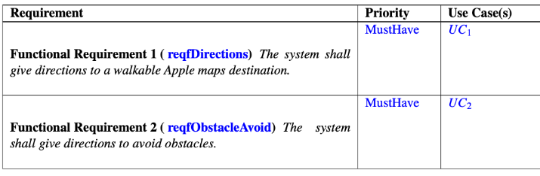
User Requirements

Slide 6
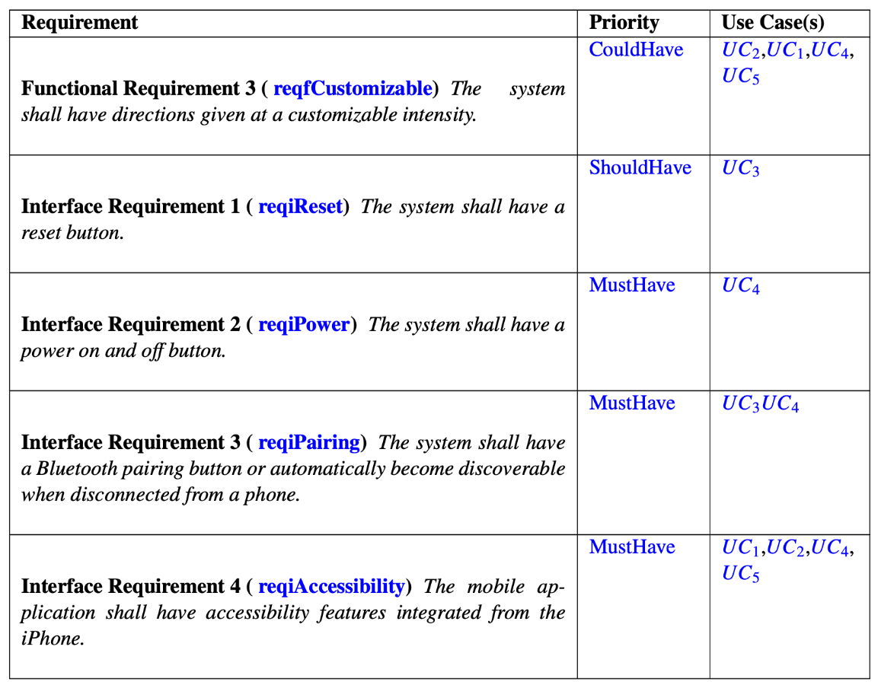
User Requirements

Slide 7
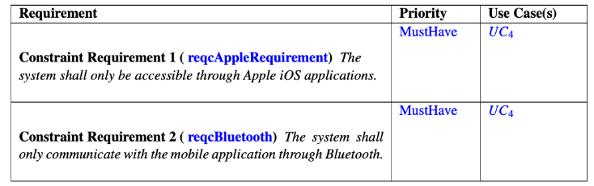
System (Constraints) Requirements

Slide 8
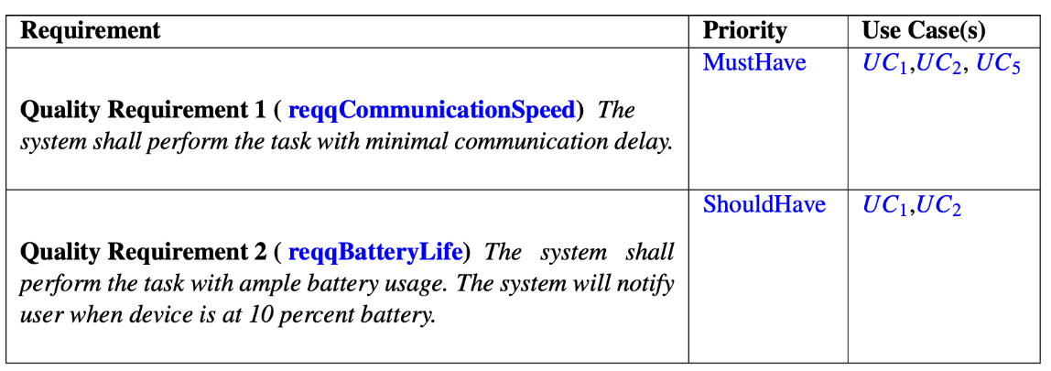
Non-Functional (Quality) Requirements

Slide 9
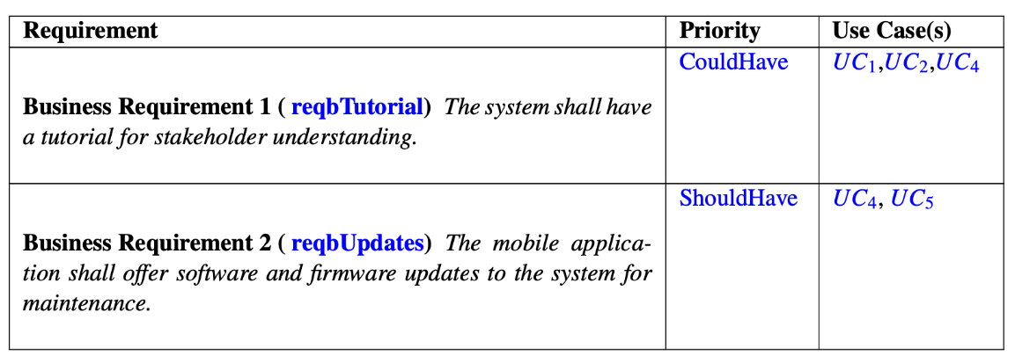
Domain (Business) Requirements

Slide 10
Use Cases
Mapping of requirements to use cases,
No new changes since adding a new use case

Slide 11
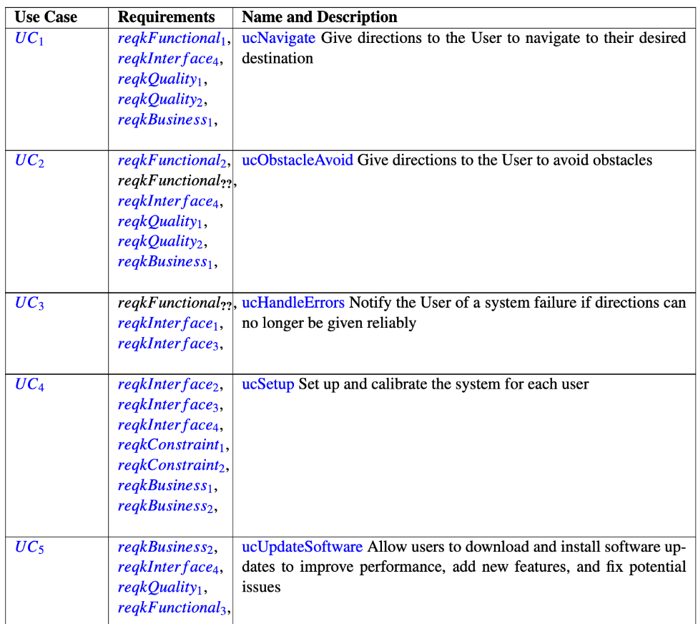
Table of Use Cases

Slide 12
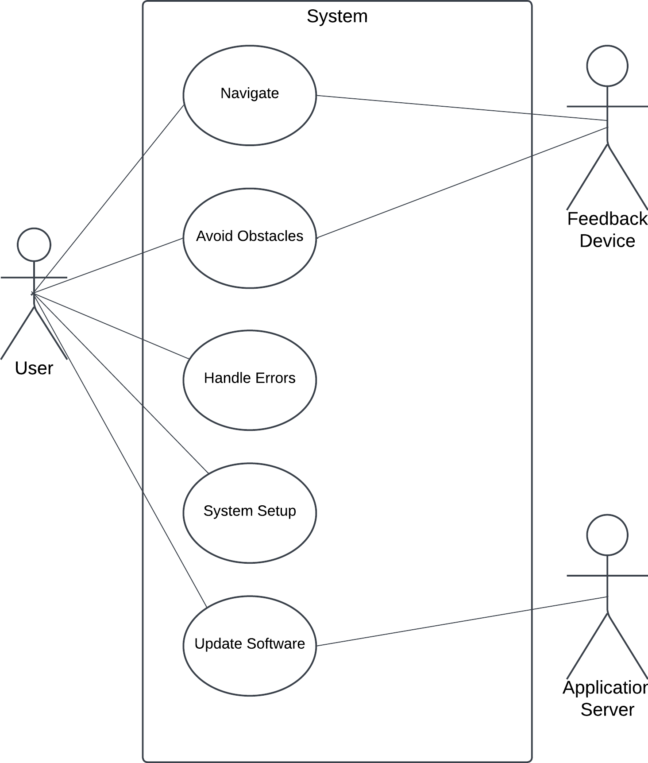
Use Case Diagram

Slide 13
Sequence Diagram
Updated sequence diagram

Slide 14
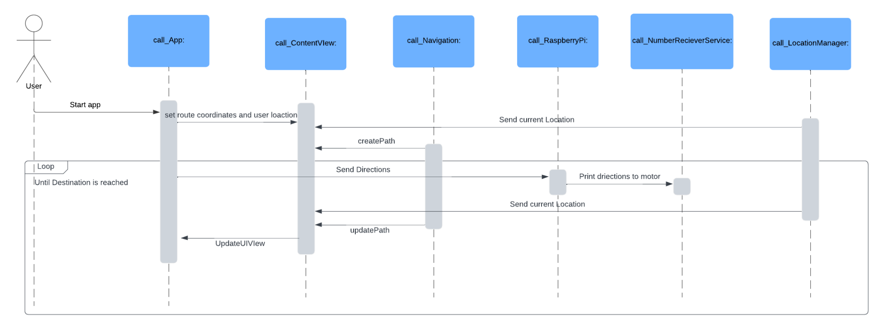
Sequence Diagram

Slide 15
Class Diagram and CRC Cards
Review of Class Diagram and CRC Cards

Slide 16
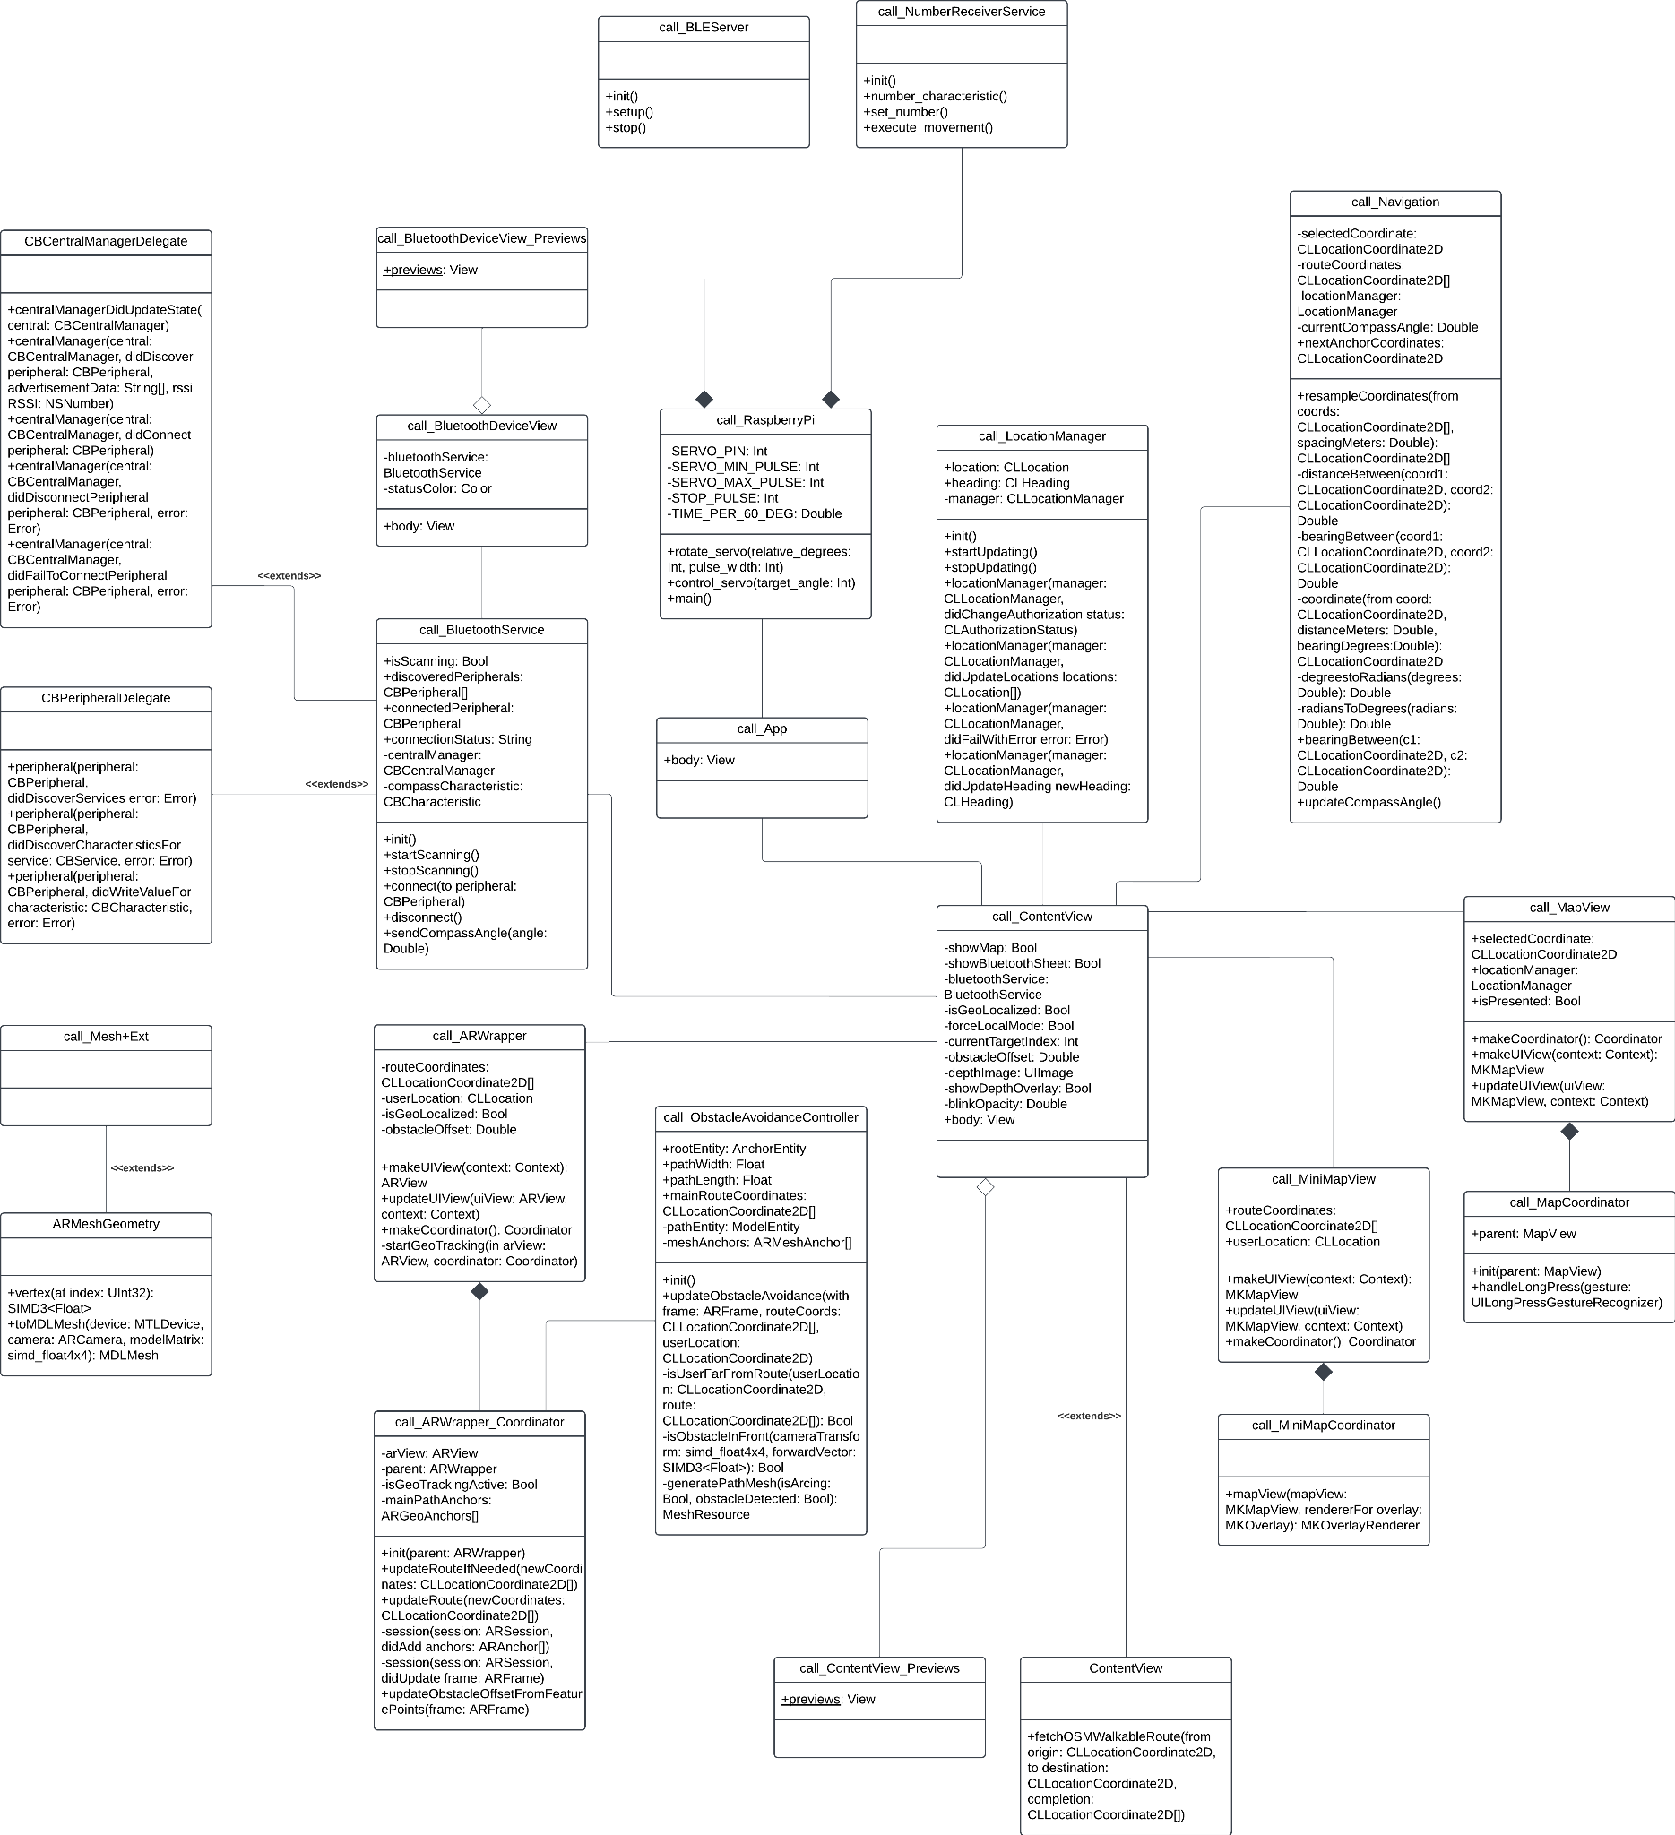
Class Diagram
Noteworthy Changes
There will be two gloves and two hardware devices
No changes are made to the actual software because it was designed in an object oriented manner
Navigation and obstacle avoidance code are already separate
Directional information printed to two motors

Slide 17
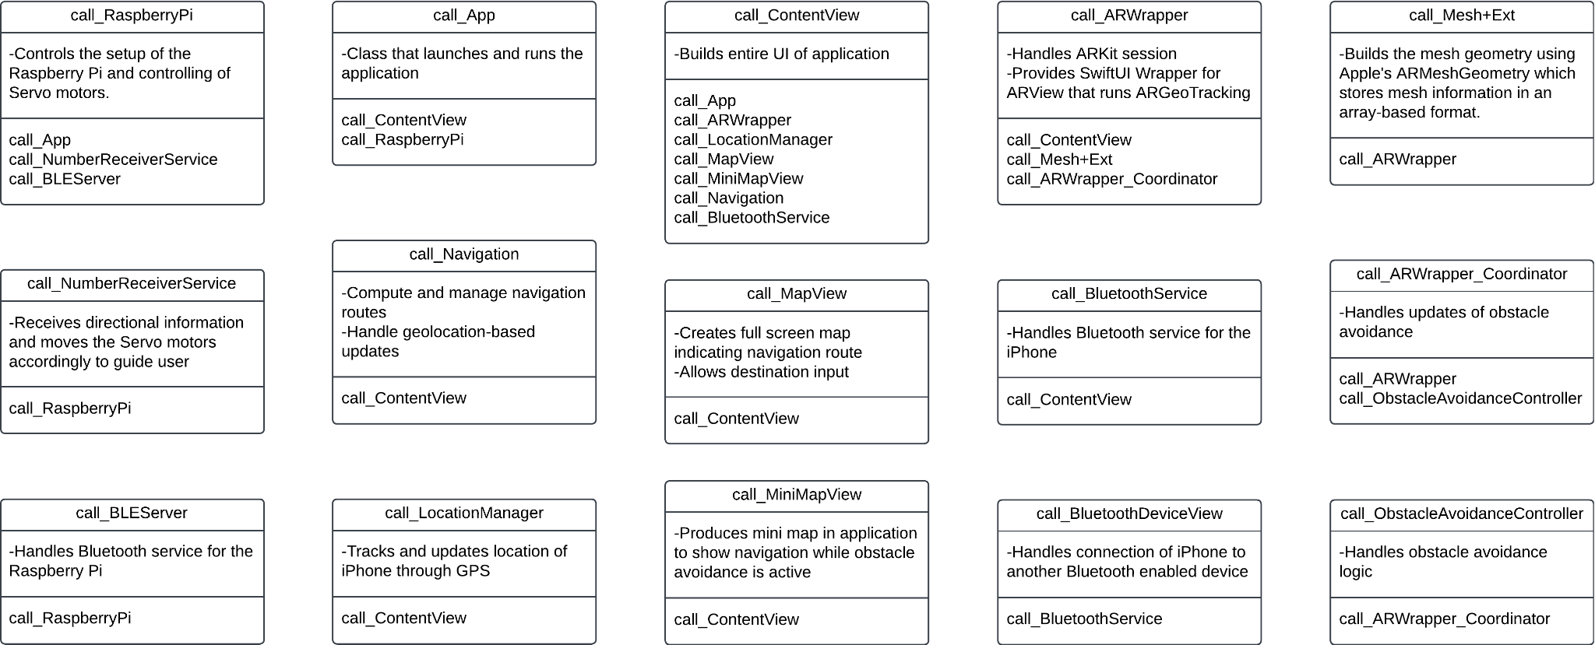
CRC Cards

Slide 18
Working Prototype Demos
Current status of the project implementation and testing

Slide 19
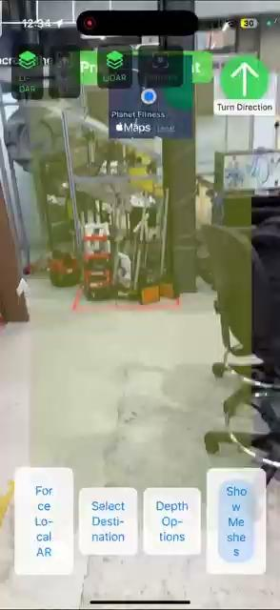

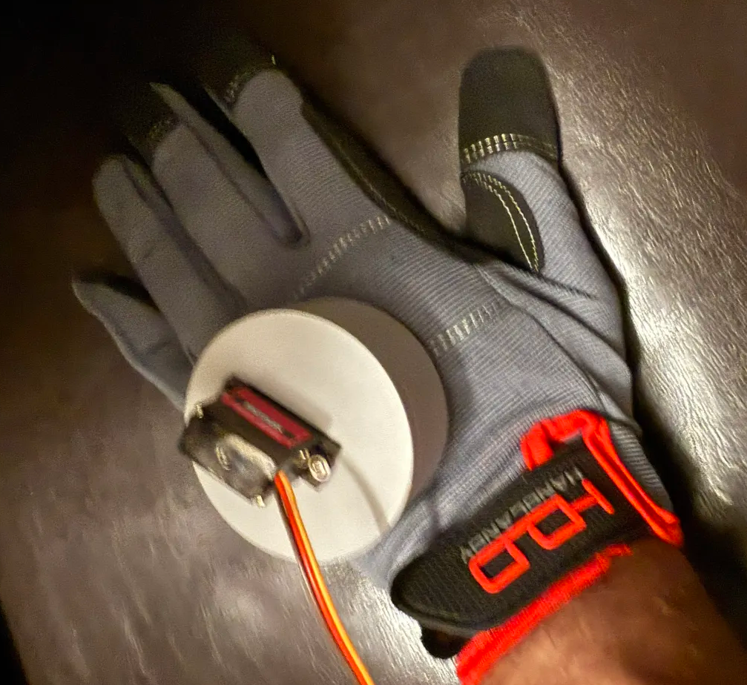
Working Prototype Demos

Slide 20
Versioning Logic
Show depots of generated versions

Slide 21
Versioning Logic
Prerequisites: Apple Developer Membership
General Steps:
Upload Build on TestFlight
Add internal testers
Obtain Feedback
Publish on App Store
Devops: TestFlight has its own CI/CD system

Slide 22
Versioning Logic
Upload Build to TestFlight
Upload to App Store Connect (Distribution Files)
Adding Test Details
Adding Test Information
Distribution Files Will Be Tracked Using GitHub
Our distribution will be versioned as follows:
Major.Minor.Change (Github Hash)
Major (X.0.0): Significant changes that may introduce breaking changes
Minor (X.Y.0): New features that are backward-compatible
Change (X.Y.Z): Small patches, Bug Fixes

Slide 23
Updated Documentation
Added new chapters to report

Slide 24
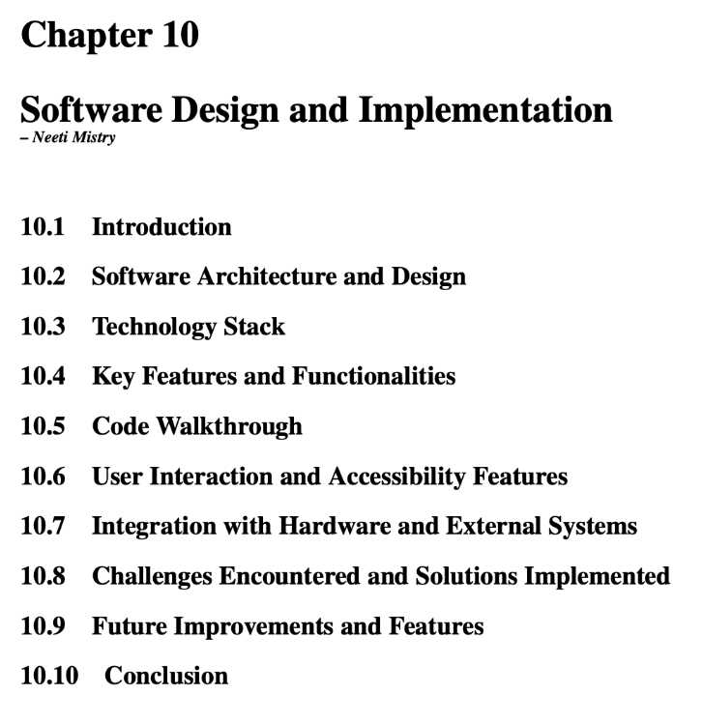
Software Design and Implementation

Slide 25
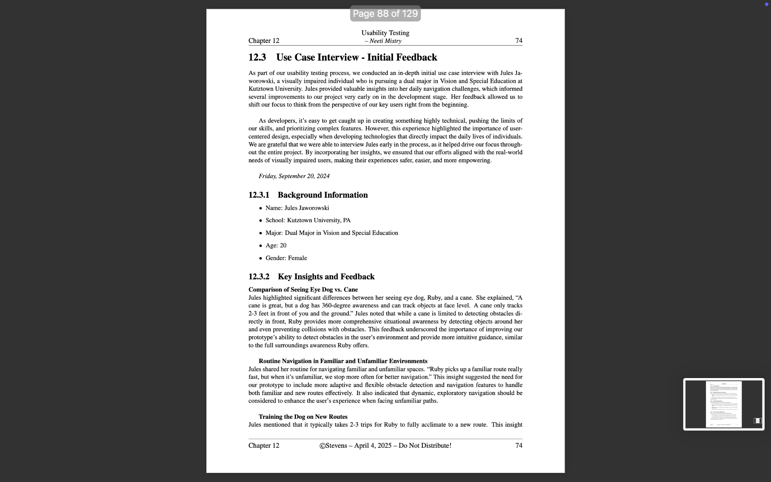
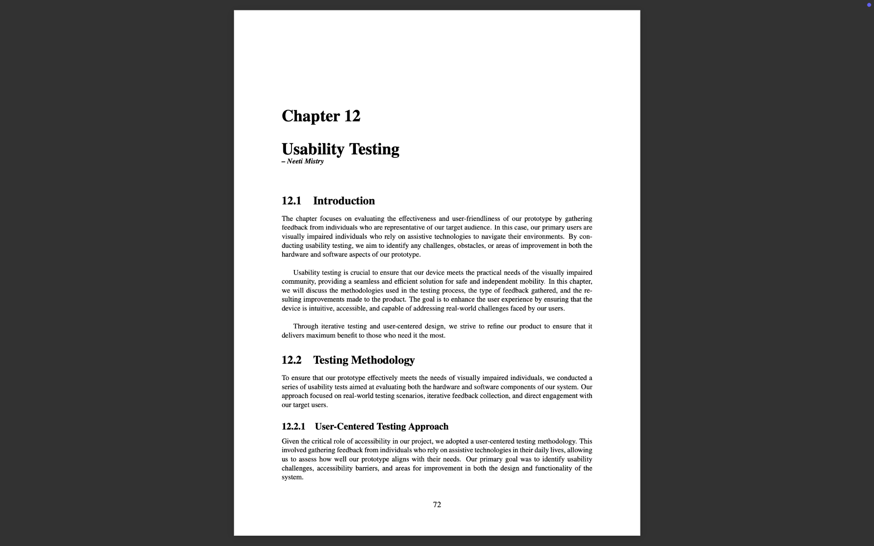
Usability Testing

Slide 26
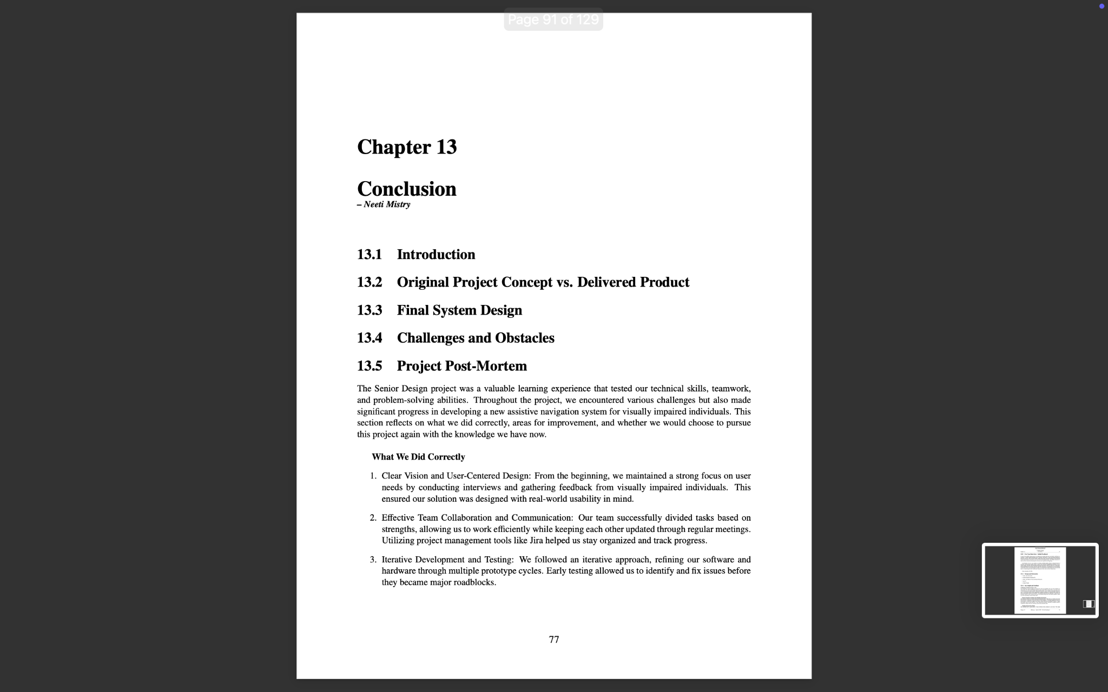
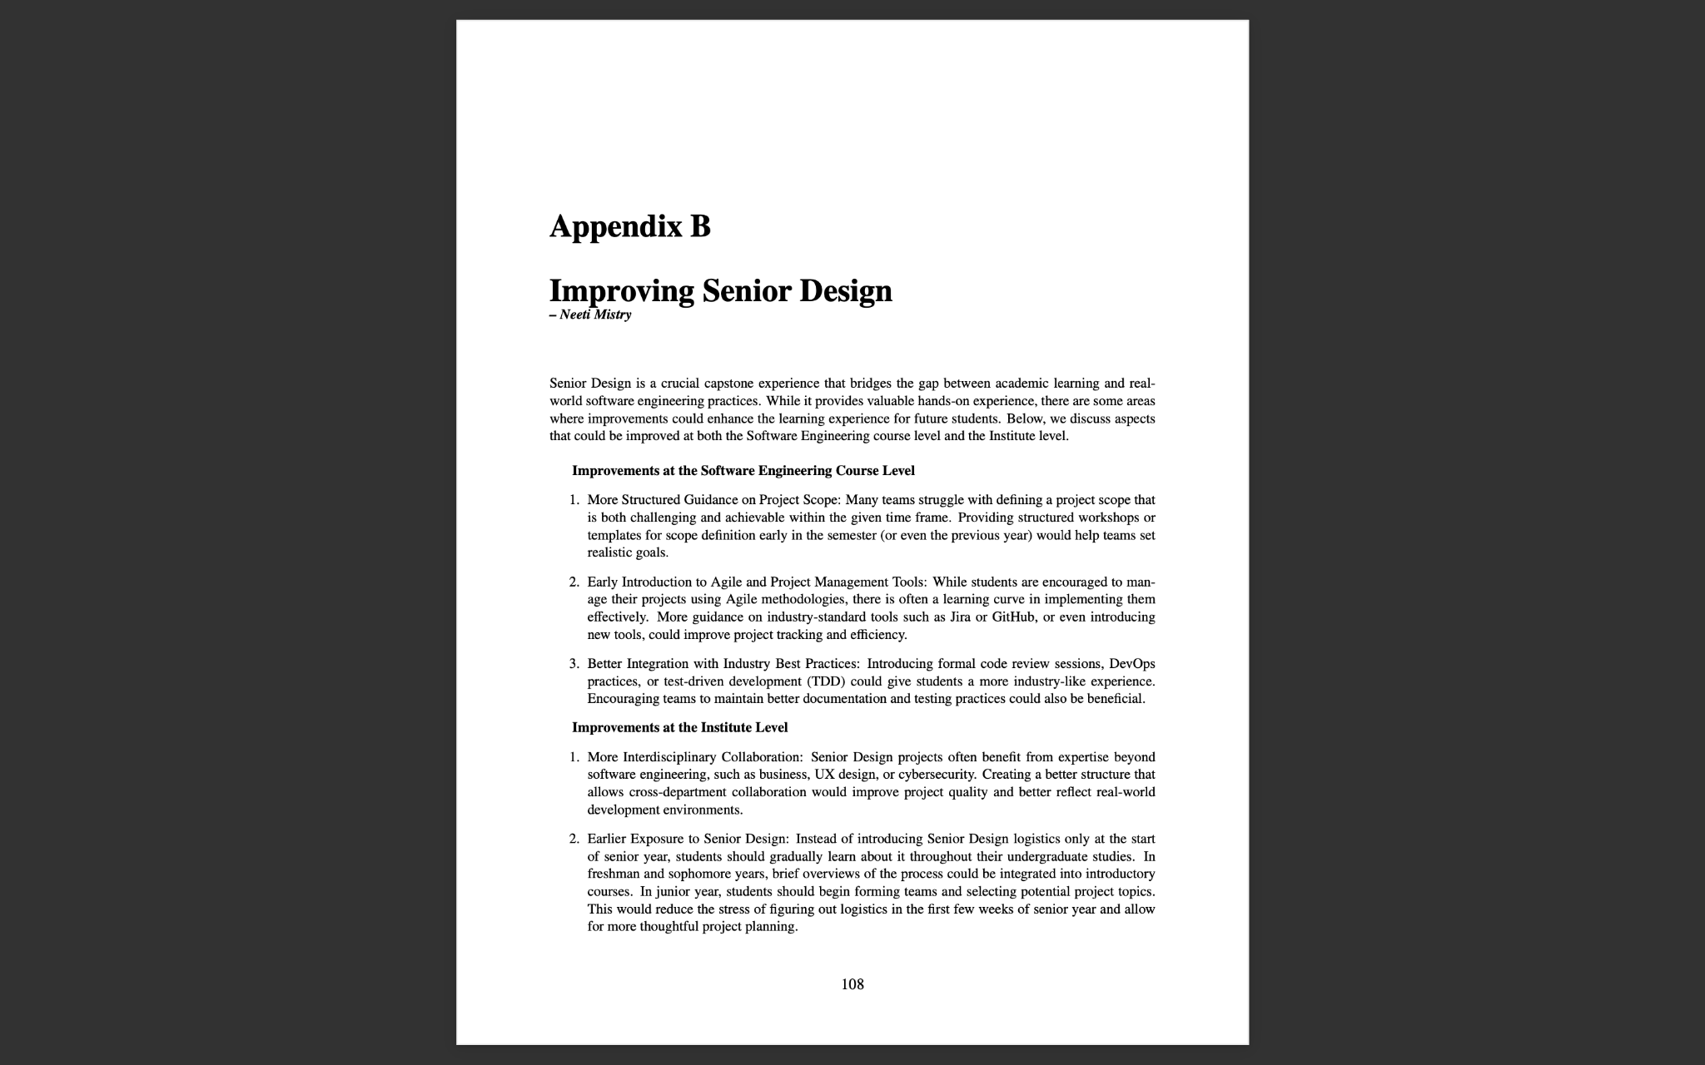
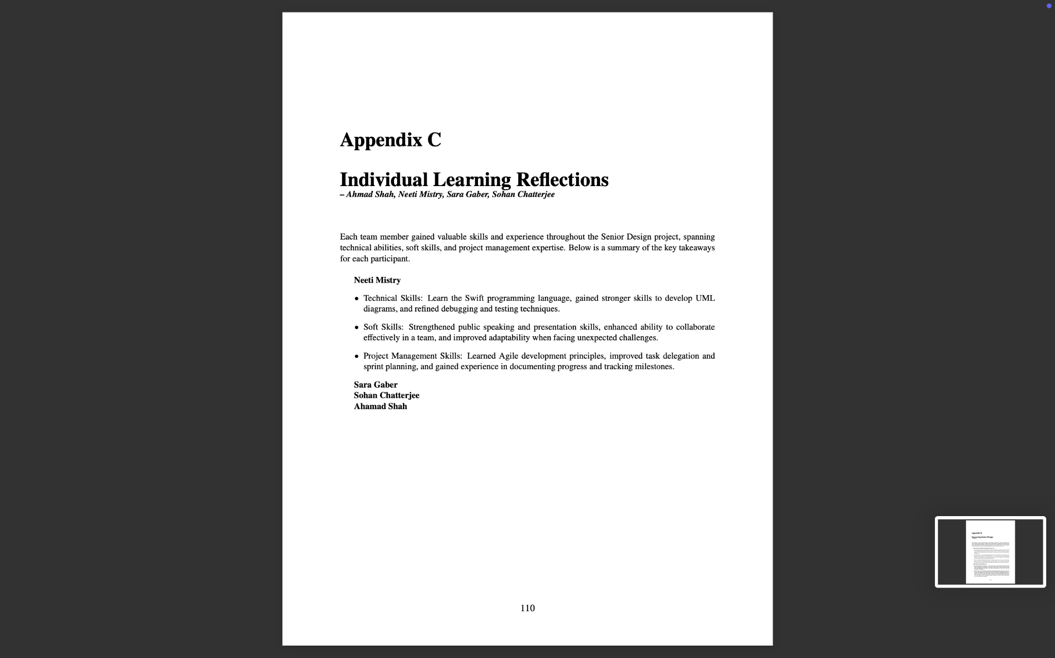
Conclusion

Slide 27
Team Logo
Developed team logos

Slide 28



Team Logo

Slide 29
Issue Tracking System
Tracking issues and tasks on Jira

Slide 30
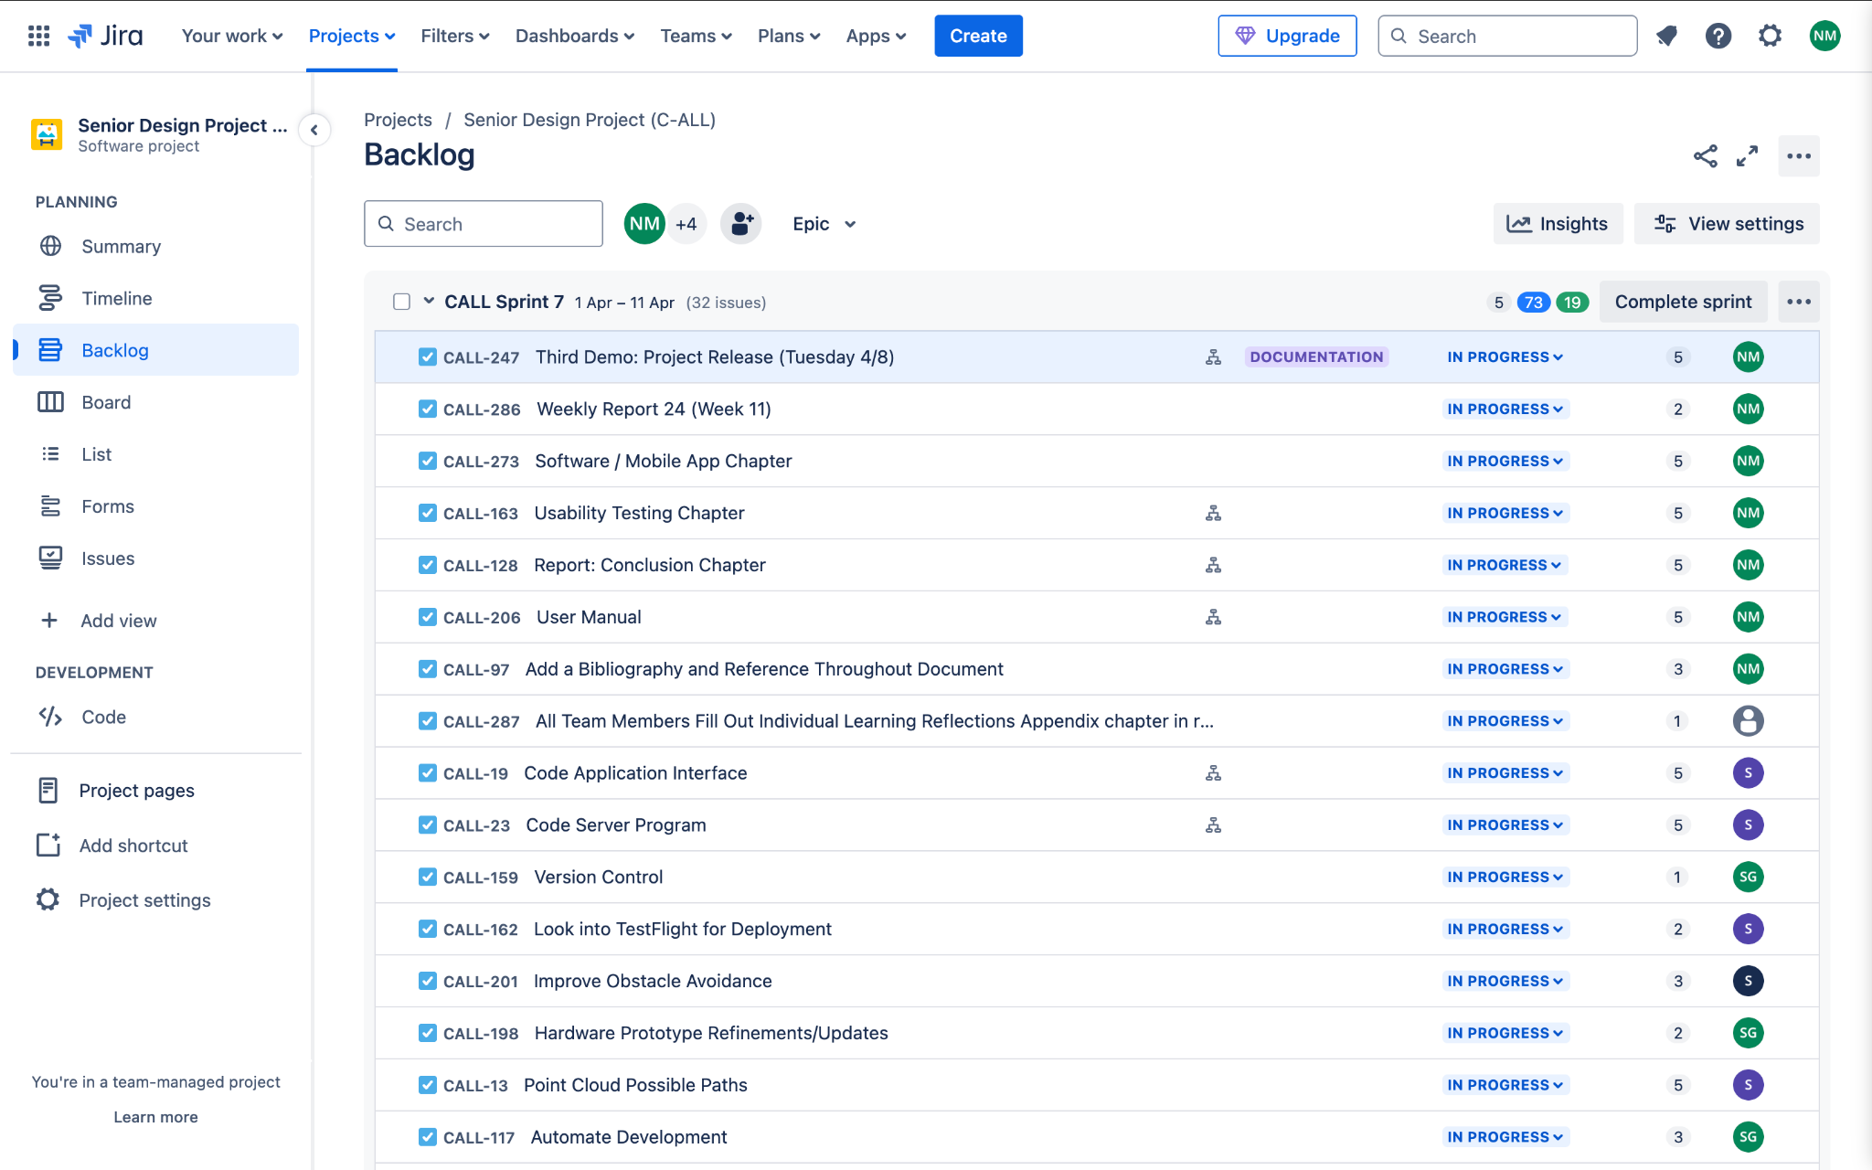
Issue Tracking System (Jira)

Slide 31
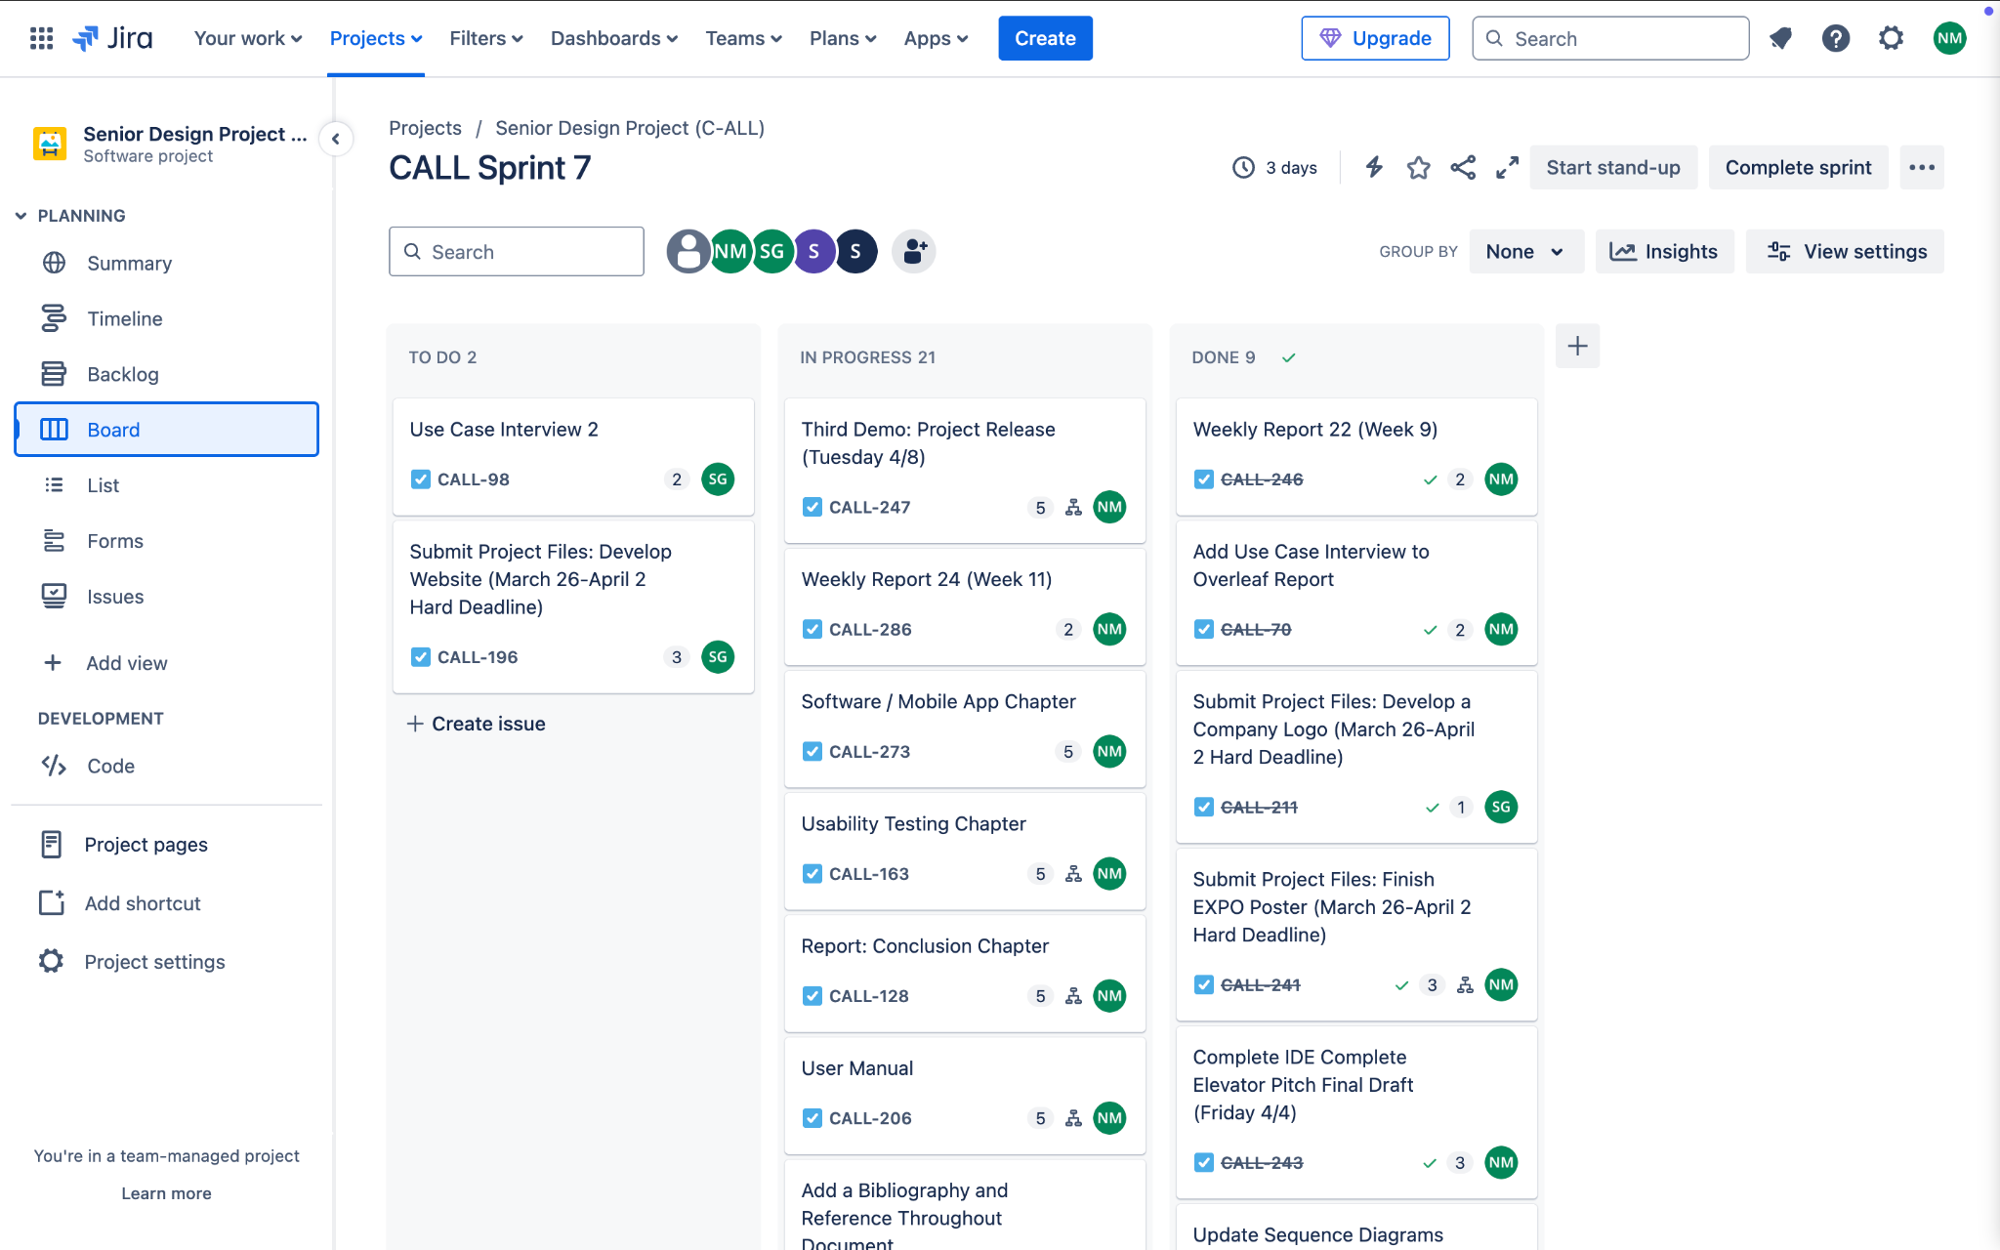
Issue Tracking System (Jira)

Slide 32
User Manual
Continue updating the user manual for additional documentation and as a user-friendly resource

Slide 33
User Manual
A User Manual was created to:
Guide Users – Provide clear instructions on setting up and using the C-ALL system effectively
Enhance User Experience – Reduce confusion and streamline system interactions
Support Troubleshooting – Offer solutions for common issues, ensuring smooth operation
Enable System Updates – Educate users on maintaining and updating the system for optimal performance
Setup Instructions
Software Updates
Maintenance & Troubleshooting
Updates
Adding additional images and figures
Hardware Block Diagram
Step-by-step illustrations for setup
Wiring Diagram

Slide 34
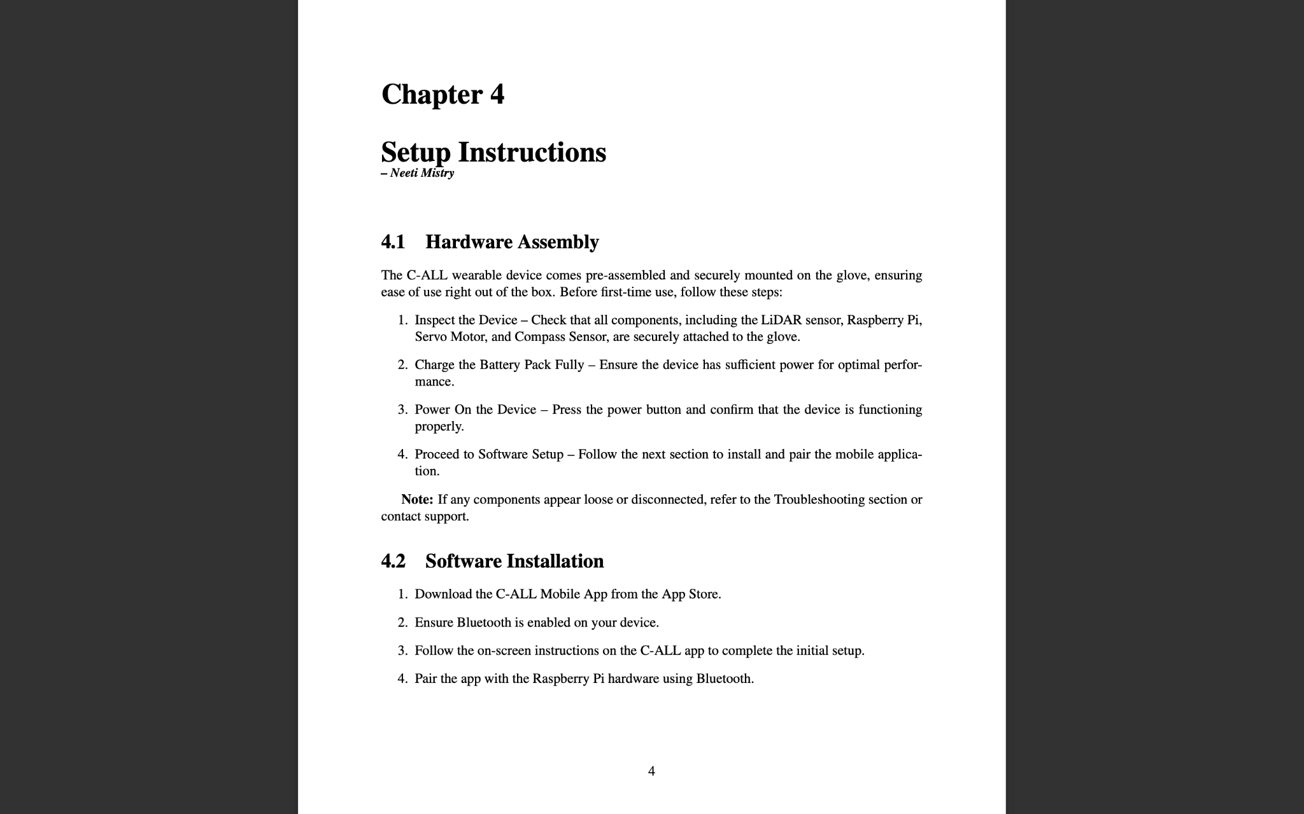
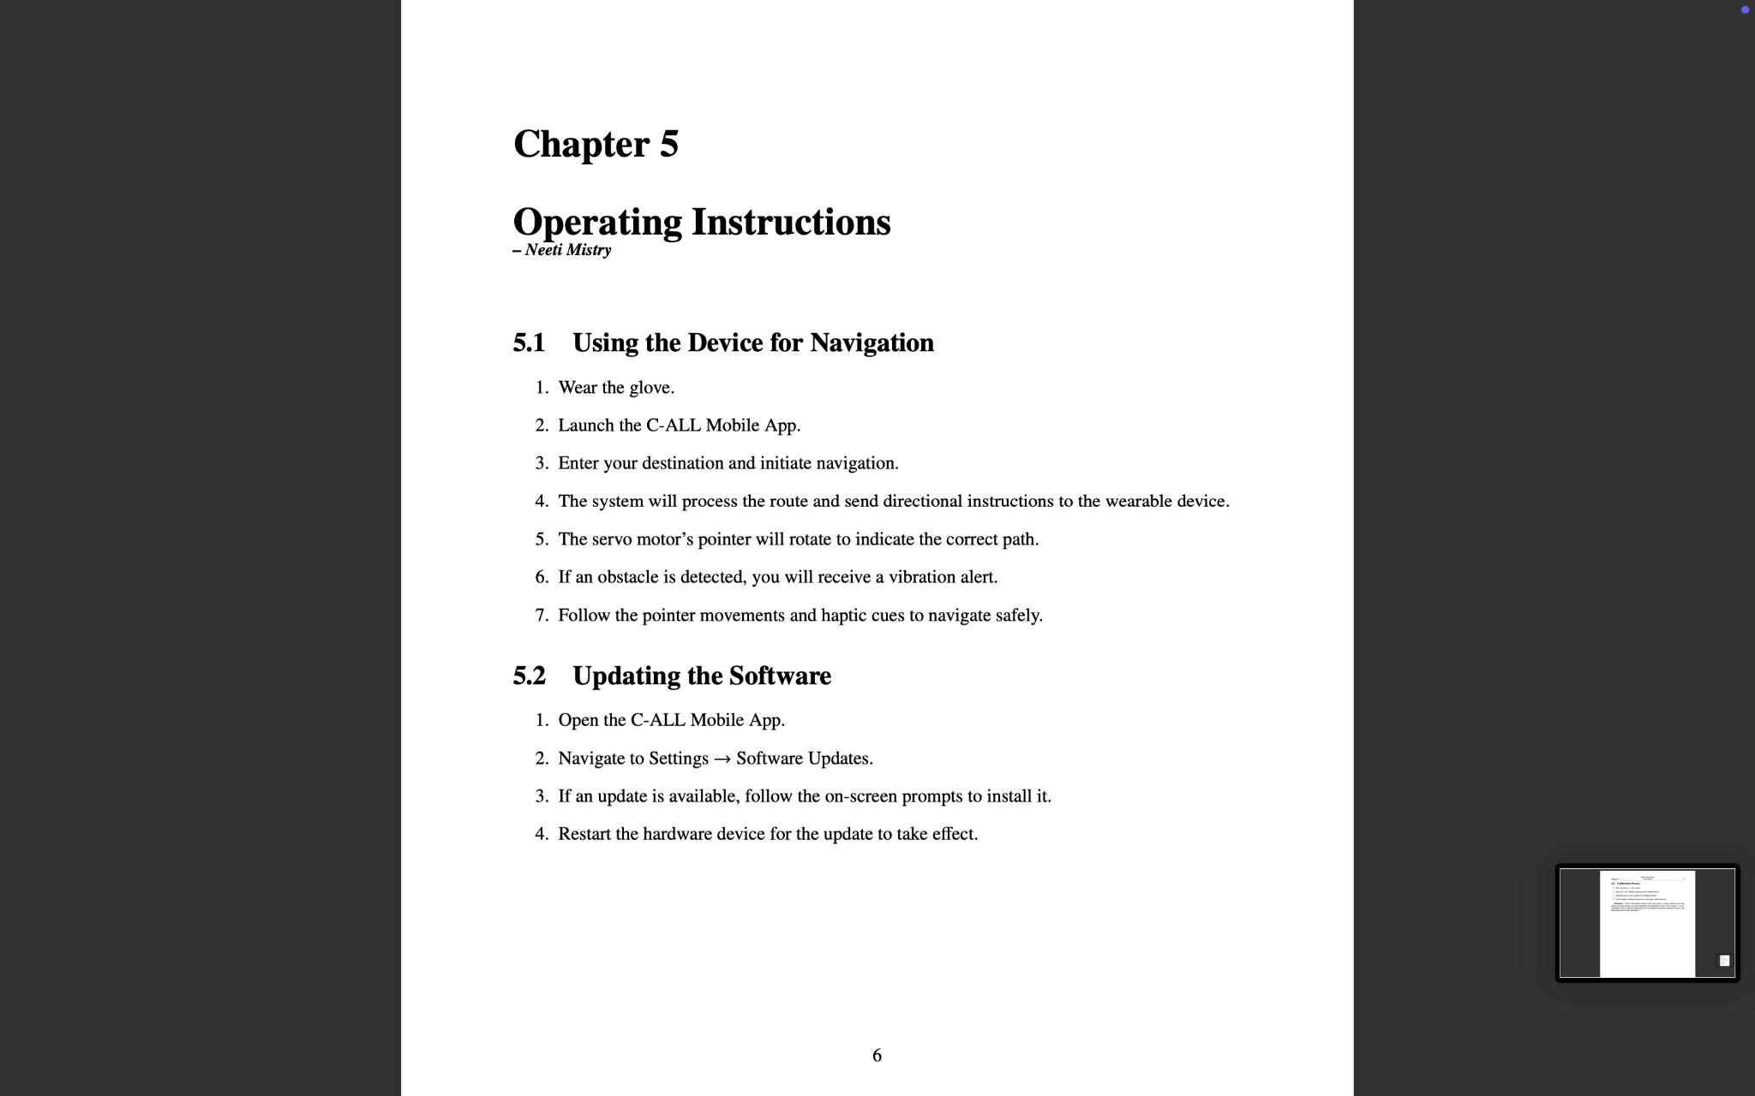
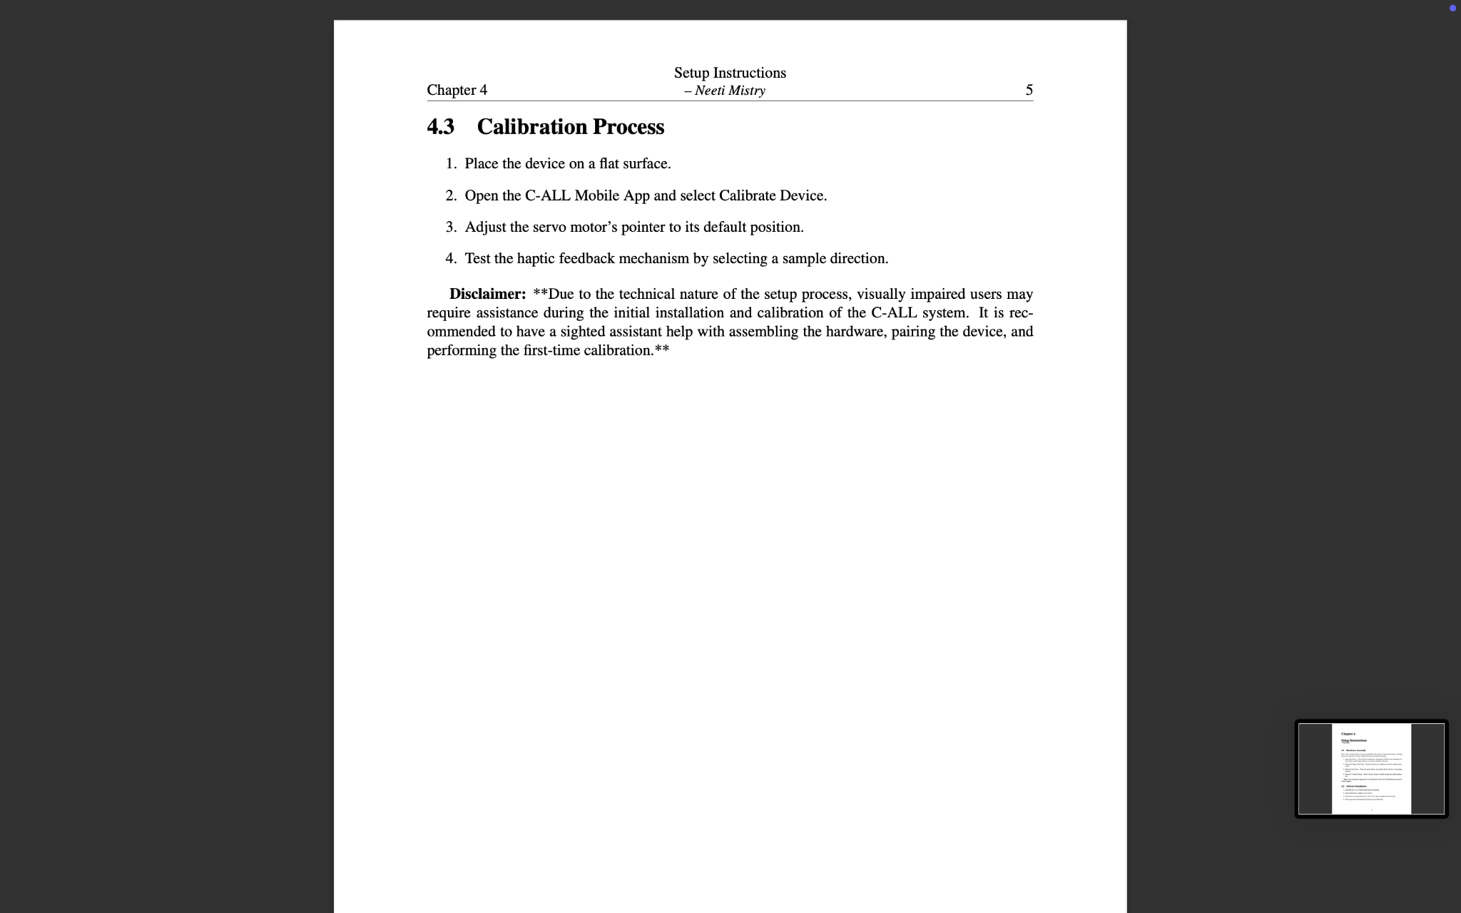
User Manual

Slide 35
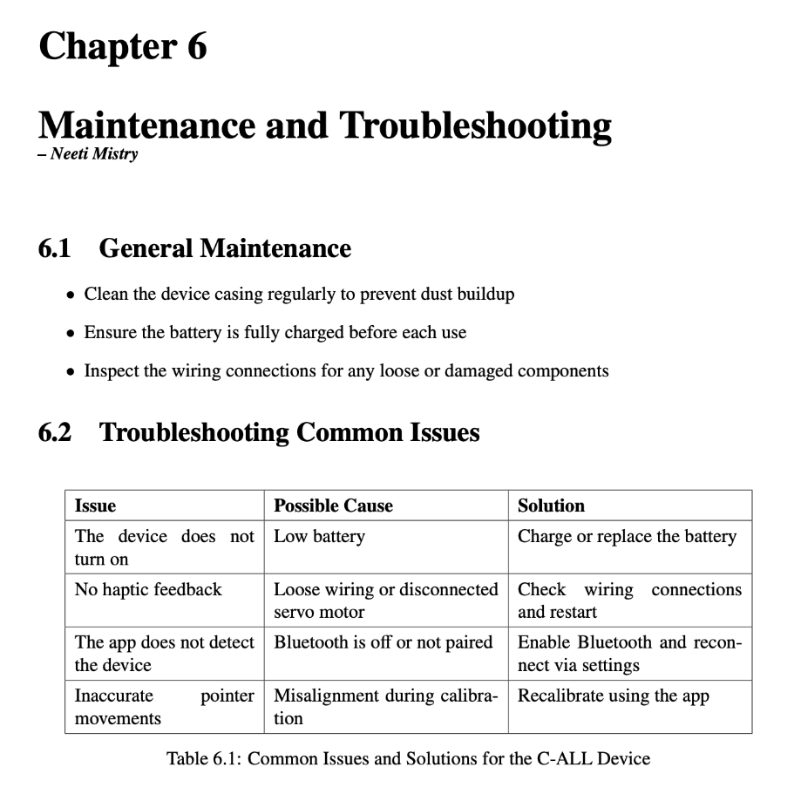
User Manual

Slide 36
Next Steps
What the Team Plans to Focus on Next

Slide 37
Next Steps
Construct Second Glove
Build a second glove that so that the instructions for obstacle avoidance and navigation are separated
Conduct Usability Testing
Gather feedback from visually impaired users to refine functionality and accessibility
Finish Implementing Versioning
Ensure smooth software updates and maintain compatibility across future iterations
Complete User Manual
Mainly focus on adding images, figures, and diagrams
Refinements
Improve hardware integration, fine-tune LiDAR processing, and enhance system responsiveness

Slide 38





Thank you!
Any Questions?

